Slide 1
Channel Models for FSO
Prepared by: Falak Shah
Kavish Shah
Guided by: Prof. Dhaval Shah

Slide 2
Table of contents
Wireless channel model
Kalmogrov theory
HVB Model
Lognormal model
Modified Rytov Theory
Gamma gamma channel model
Negative Exponential model
K channel model
I-K channel model
References

Slide 3
Wireless model for FSO
The wireless channel model is given by [1],
Where s = ηI denotes the instantaneous intensity gain.
x ∈ {0, 1} the OOK modulated signal.
n ∼ N (0,N0/2) the white Gaussian noise with mean 0 and variance N0/2 because of random nature of electrons at receiver electronic circuitry.
η the effective photo-current conversion ratio of the receiver. Where η is defined by,
Where 𝛾 is the quantum efficiency of the photo receiver, e the electron charge, λ the signal wavelength, ℎ𝑝 Plank’s constant and c is the speed of light.
I is the irradiance And definition of I will change according to models.

Slide 4
Kalmogrov theory
Eddies are vortex due to flow of wind at any geographical location and are main cause of turbulence.
Kolmogorov’s theory describes how energy is transferred from larger to smaller eddies and how much energy is dissipated by eddies of each size. Atmospheric turbulence is derived using Kalmogorov theory as,
Where L0 and l0 are large and small eddy size of 10-100 m and 1 cm, respectively, 𝐶_{𝑛} ² is the refractive index parameter giving the spatial frequency based on geographical location, altitude and time of day. Values of 𝐶_{𝑛}² [2] for different turbulence levels like weak turbulence, moderate turbulence and strong turbulence:
= 10-17 m-2/3 for weak turbulence
= 10-15 m-2/3 for moderate turbulence
= 10-13 m-2/3 for strong turbulence

Slide 5
Hufnagel valley boundary theorem
Refractive index structure parameter is almost constant for horizontal path propagation. But in vertical path propagation, temperature gradient is different at different altitude so it varies with altitude.. The mathematical model of HVB is as shown below,
Where a1= 5.94 x 10-23, a2= 2.7 x 10-16,
s1=1000 m, s2= 1500 m, s3= 100 m
h is altitude (m),
V is the rms wind speed in m/s. The refractive index structure parameter versus the altitude, h has been shown in figure for HVB-21 model with V= 21 m/s.
For different values of _{𝑛}²(0), 𝐶_{𝑛} ² decreases with increasing height and is nearly independent of 𝐶_{𝑛}²(0) for altitude greater than 1 km.

Slide 6
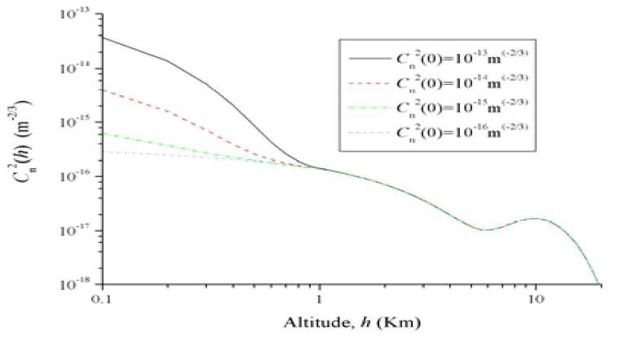
HVB-21 model C_{n}² variation

Slide 7
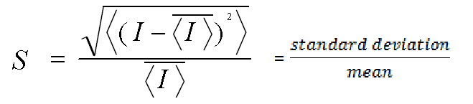
Scintillation Index
Scintillation is caused by small temperature variations in the atmosphere, which results in index of refraction fluctuations.
Scintillation is defined by, S
where I denote irradiance that is the received intensity of the optical field after passing it through turbulent medium.
Based on the value of S, turbulence can be identified as strong or weak.

Slide 8
Lognormal Channel
In lognormal channel model, irradiance I is
Where, Z is the Gaussian distribution with Mean 0 and variance σ².
So, I will follow log-normal distribution with
mean
and variance [3] .
Based on the relation,
we obtain and for summing this, we use power series to obtain BER equation as,

Slide 9
Lognormal Channel
Where P_{e,L} is bit error rate probability which is a function of ϒ_{g} (signal to noise ratio) and σ_{x} (fading intensity).SNR can be calculated by,
Where, R is responsivity of receiver,
P is transmitted power.
σ1 and σ0 are standard deviation of noise currents for symbols ‘1’ and ‘0’.
The above equation of SNR can be expressed in terms of h for fading channels as,

Slide 10
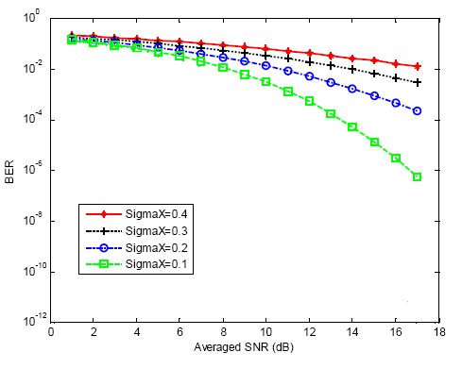
Simulation BER v/s SNR lognormal
Performance of perfect CSI at receiver for log-normal channel model

Slide 11
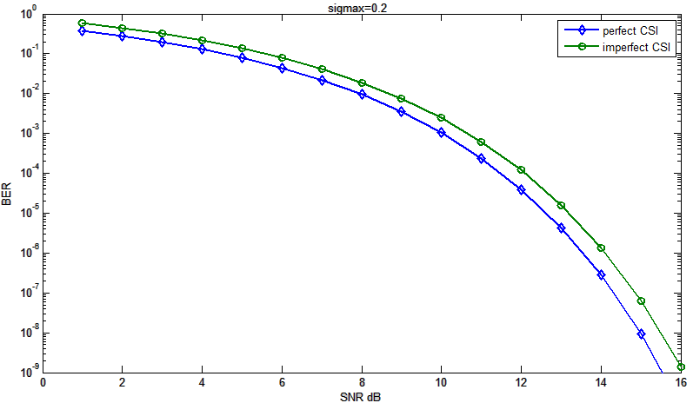
Lognormal with imperfect CSI
Gauss-Markov Model is described as,
Using h1 instead of h in BER equation, we have got comparison of with CSI and without CSI as below,

Slide 12
Modified Rytov Theory
Andrews proposed the modified Rytov theory [4,5], which defines the optical field as,
Where are statistically independent complex perturbations which are due only to large-scale and small-scale atmospheric effects, respectively.
The perturbation ψ 1(r, L)= χ1(r, L)+ jξ1(r, L) is a complex Gaussian random process
U₀(r, L) is the optical field in the absence of turbulence
where r is the observation point in transverse plane at propagation distance L,

Slide 13
Gamma Gamma Channel
Specifically, in [6], gamma pdf is used to model both small-scale and large scale fluctuations, leading to the so-called gamma-gamma pdf,
Where K_{a}(.) is the modified Bessel function of second kind of order a. α and are the effective number of small scale and large scale eddies of the scattering environment.

Slide 14
Gamma gamma channel
Now from this result, we can find the BER performance of scheme as,
Where D(θ) is given by,
Where c1 is given by,
τ = Es/N0
And c2 is given by,

Slide 15
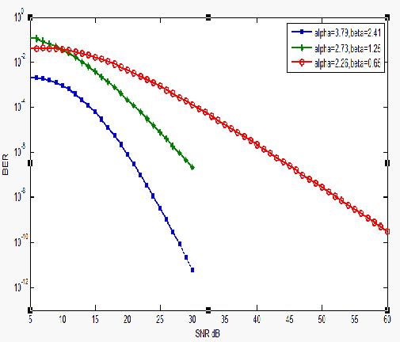
BER v/s SNR for gamma gamma

Slide 16
Negative exponential model
In strong turbulence, more irradiance fluctuations.
Where link length spans several kilometers, number of independent scatter become large.
Signal amplitude - Rayleigh fading distribution,
Signal intensity - negative exponential statistics.
Where I₀ is mean radiance of channel.

Slide 17
K Channel model
For strong turbulence channels.
Excellent similarity between theoretical and experimental values.
pdf of irradiance - governed by the negative exponential distribution [8].
Where is mean irradiance of channel.

Slide 18
K Channel model
Converting the above equation,
We can find pdf of I as follows,
This integration results as,

Slide 19
K Channel model
Using a simple transformation, SNR is obtained as,
Using the equation of Chanel capacity,
Pdf of C is,

Slide 20
I-K Channel model
In both scenarios- weak turbulence and strong turbulence.
Less computation complexity than gamma-gamma channel model.
This channel model is preferred over others [8].
The PDF of normalized signal irradiance is given as,

Slide 21
I-K Channel model
Again using a simple transformation, SNR is obtained as,

Slide 22
I-K channel model
Using equation of channel capacity,
The pdf of capacity can be given as,

Slide 23
I-K channel model
Outage probability can be found using channel capacity as,
Value of outage probability can be shown as,

Slide 24
Summary
Lognormal channel model is used in weak turbulence scenario and key factor is .
Gamma-Gamma channel model is used in weak to strong turbulence scenario and key factors are .
K channel model is used in strong turbulence scenario and key factor is
I-K channel model is used in strong turbulence scenario and key factor is .

Slide 25
Reference
Murat Uysal, Jing (Tiffany) Li, Error Rate Performance of Coded Free-Space Optical Links over Gamma-Gamma Turbulence Channels, Communications, 2004 IEEE International Conference, 20-24 June 2004, 3331 - 3335 Vol.6.
ARNON S.: ‘Optical wireless communications’, chapter in the Encyclopedia of Optical Engineering (EOE), R.G. DRIGGERS (ED.) (Marcel Dekker, 2003), pp. 1866–1886
Hassan Moradi, Maryam Falahpour, Hazem H. Refai, Peter G. LoPresti, Mohammed Atiquzzaman, BER Analysis of Optical Wireless Signals through Lognormal Fading Channels with Perfect CSI, Telecommunications (ICT), 2010 IEEE 17th International Conference Publications, 493 – 497..
L. C. Andrews, R. L. Phillips, C. Y. Hopen and M. A. Al-Habash, “Theory of optical scintillation”, Journal of Optical Society America A, vol. 16, no.6, p. 1417-1429, June 1999.
L. C. Andrews, R. L. Phillips and C. Y. Hopen, “Aperture averaging of optical scintillations: Power fluctuations and the temporal spectrum”, Waves Random Media, vol. 10, p. 53-70, 2000.

Slide 26
References
6. M. A. Al-Habash, L. C. Andrews and R. L. Phillips, “Mathematical model for the irradiance probability density function of a laser beam propagating through turbulent media”, Optical Engineering, vol. 40, no. 8, p. 1554-1562, August 2001
LETZEPIS, N., FABREGAS, A. G. Outage probability of the free space optical channel with doubly stochastic scintillation. IEEE Transactions on Communications, 2009, vol. 57, no. 10.
Hector E. NISTAZAKIS, Andreas D. TSIGOPOULOS, Michalis P. HANIAS, Christos. D. PSYCHOGIOS, Dimitris MARINOS, Costas AIDINIS, George S. TOMBRAS, Estimation of Outage Capacity for Free Space Optical Links over I-K and K Turbulent Channels, RADIOENGINEERING, VOL. 20, NO. 2, JUNE 2011.

